Slide 1
LAUNCH WEBINAR Tuesday 1st April – 11 am

Slide 3
Our brand
Recognise excellence
Support where needed
For the Greater Good
Our values
What makes us us (our culture)
Our mission
The roadmap/methodology (our how)
All of our members actively support, promote and contribute to advancing standards in pharma marketing & communications. And the profits we make through our initiatives are put right back into funding programs that help people get into the industry and healthcare charities.
We see a world where everyone in pharma marketing & comms has a role to play in advancing standards. We provide the unique space for individuals & organisations to support, promote, and contribute.
Our vision
Our ultimate destination (our why)
Brand positioning
Our place in the market (our place to win)
The PM Society is the not-for-profit partner to the UK pharmaceutical industry helping drive standards forward in healthcare marketing & communications

Slide 4
Did you know we are a not-for-profit organisation?
Charity programme Over the past ten years alone, we have given over £150,000 to the different charities we have supported. Some of this has come from fundraising at the PM Society Awards and the PM Society Digital Awards each year. The PM Society has topped up donations each year where we have profit.
Creativity For Good The Creativity For Good initiative was launched in 2021 and has grown from strength to strength with more agencies wanting to take part each year (there were 21 agencies in 2024 who attended the briefing session). Simply put, this is a competition that challenges agencies to build a campaign pro bono for a chosen charity each year.
Careers Event Now in its fifth year, our Careers event, held at the Royal Society of Medicine, is a FREE annual event to encourage students (post- and under-grad) and early career changers, to learn about the variety of careers in the pharmaceutical and healthcare communications industry and network with potential employers.
Careers Engagement Officer In 2023, we co-funded a Careers Engagement Manager, along with the Healthcare Communications Association. This role is helping to raise awareness of the career opportunities within healthcare communications, while also attracting new talent into the sector.
Interest Group activities We have 8 Interest Groups which all require some degree of funding to continue. Diversity, Equity & Inclusion, Digital, Industry/Agency Relationships, L&D, Patient Engagement, Sustainability, Marketing Leadership, and Careers.
Sponsorship of relevant initiatives If it aligns with our brand values, we look to help other folk doing similar things, e.g. Sponsorship of the recent Women In Pharma meeting.

Slide 5
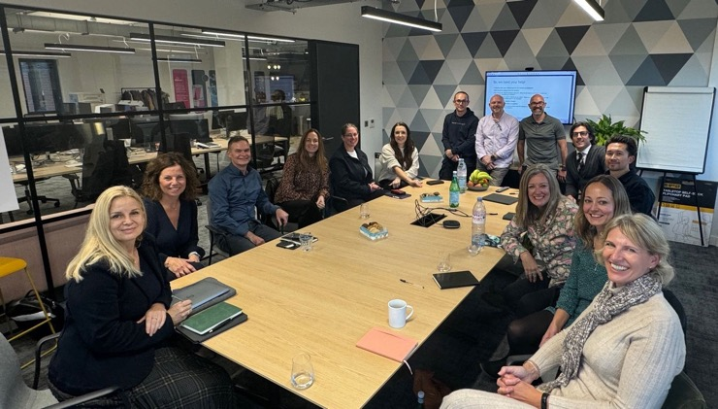
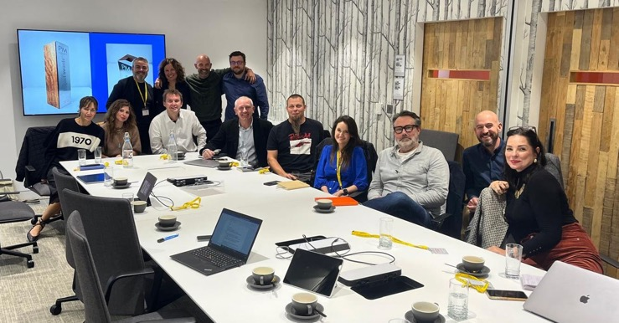
The evolution of the PM Society Digital Awards
After taking feedback from our membership, this successful event has evolved and sharpened its focus on innovation and impact.
As the PM Society sets out its new vision to advance standards in our industry, so too the awards programme has been refreshed and modernised to reflect this evolution.
The emphasis is still on effectiveness (impact) and innovation in the concepts, formats, design of content and the use of a variety of media and channels.
The categories and judging criteria have been revised in line with the new direction, and some tweaks made to long-running categories.

Slide 6
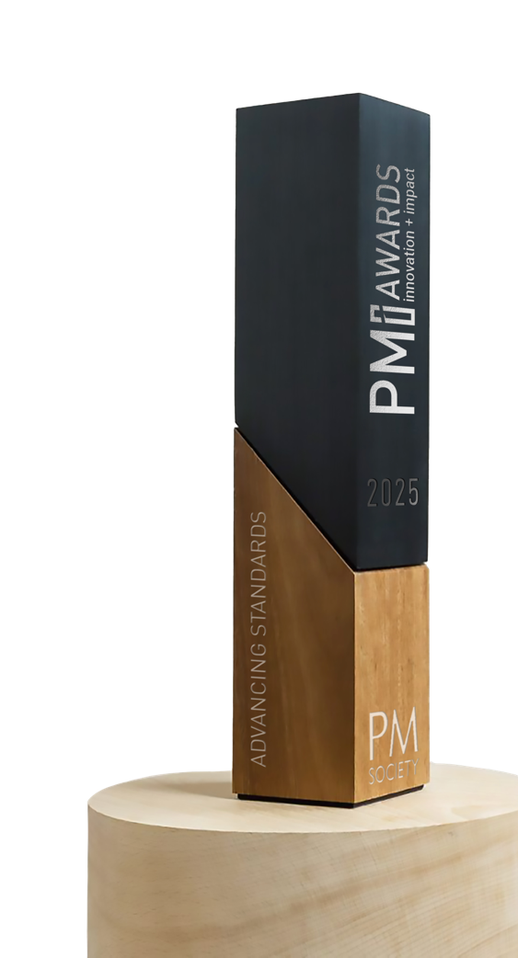

Slide 7
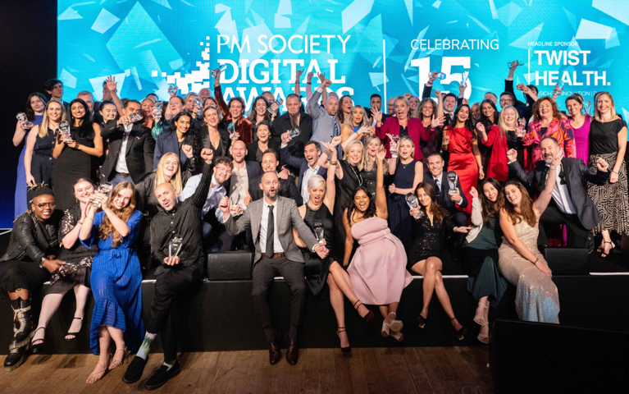
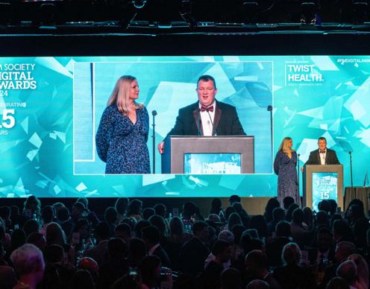
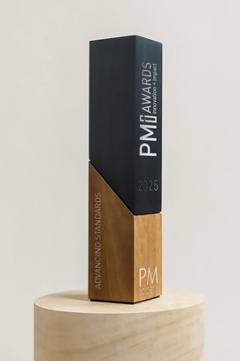
The evolution of the PM Society Digital Awards
Formerly the PM Society Digital Awards, running for 15 years
The emphasis is still on effectiveness (impact) and innovation
Held at The Brewery, London, Thursday 11th September 2025
An amazing evening of networking with over 500 industry colleagues
Judging panels contain a mix of specialists (agency & client side)
As a finalist you present your work to panels of judges at a live second round over Zoom/Teams
Full range of entering companies across Creative/Advertising, Med Comms, PR, Digital, Med Ed, Charities as well as Pharma Companies entering directly

Slide 8
WHY ENTER AWARDS?

Slide 9
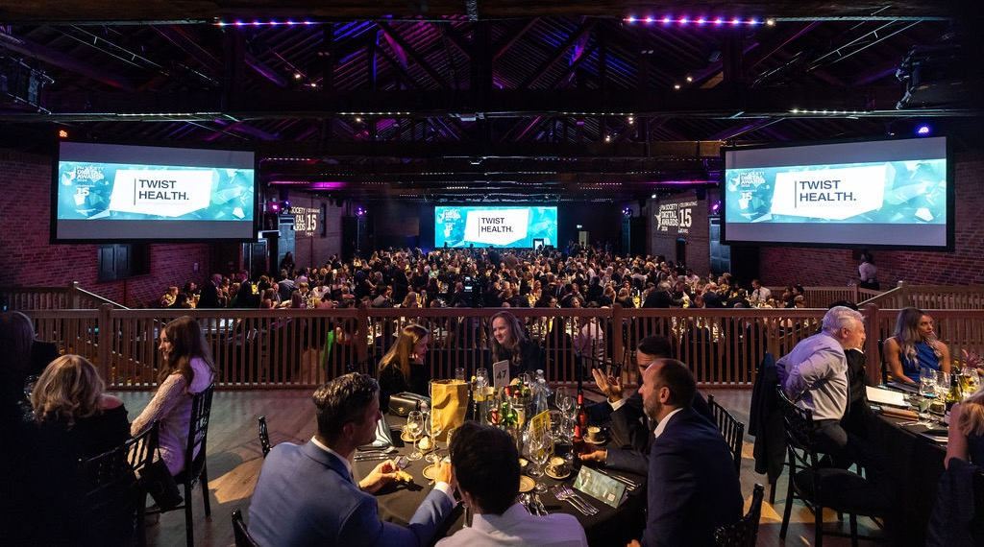
Why enter awards?
A recognition of “real work that really works”
Your work (and therefore your company profile) gets seen by pharma judges at all stages
PR opportunities for all finalists and, of course, the “winner”
You will receive a logo for use on your website or email signature
You can access photos of your team on stage
Celebration opportunity for team

Slide 10
EXISTING, NEW, AND EVOLVED CATEGORIES

Slide 11
The evolution of the PM Society Digital Awards
Long standing categories remain:
Brand promotion
HCP education, training and support
Disease and/or health awareness
Congress, meetings and events
Patient support programmes
Customer engagement excellence
External and Internal Communications
Evolving for success
Healthcare charities
Film, animation and video

Slide 12
The evolution of the PM Society Digital Awards
New or evolved categories are:
Independent medical education
Clinical trial recruitment and retention
Impact in pharma technology
Innovation in marketing and communications

Slide 13
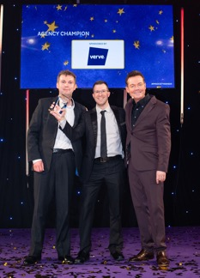
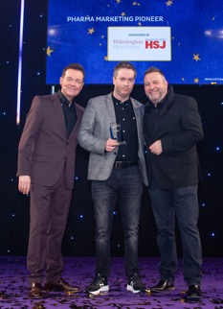
The evolution of the PM Society Digital Awards
People categories are:
Agency champion of the year
Pharma partner of the year
Agency of the Year (headcount over 30)
Agency of the Year (headcount under 30)

Slide 14
Judging process (excl. people awards)
60+ highly skilled, and experienced judges from the pharma industry with expertise across marketing, communications, digital, creative and agency leadership
Stage one
Judges review all entries online (alone) and score each on the basis of the criteria set
Based on scores alone, the top 3 – 7 are chosen to be FINALISTS (depending on the number of entrants and how close the scores are)
Finalists are informed
Stage two
Finalists will be invited (agency + client) to attend online face-to-face judging days in mid July
Each entrant will be given 15 minutes. 10 minutes for presenting and 5 minutes for questions from the judges

Slide 15
Entry deadlines
Early bird entry deadline
Tuesday 6th May (Midnight)
Entry deadline
Tuesday 13th May (Midnight)
Final deadline, all entries must be completed
Tuesday 20st May (Midnight)

Slide 16
What information do you need to enter?
Ultimately, we are looking for innovation & new thinking married with proof points to show success (impact)
The weighting of different criteria varies between categories – so take a look at the information on the website
Impact can be evidenced by both quantitative data and qualitative feedback
In short, if you have work that is truly innovative and creative and/or has great metrics to show success, we want to celebrate your work

Slide 17
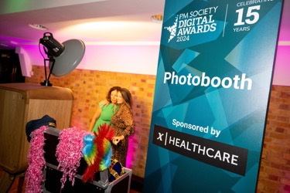
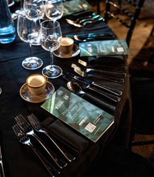
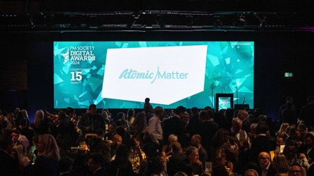
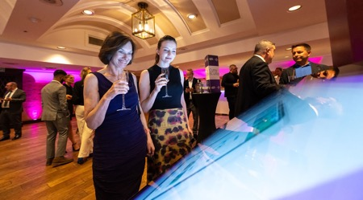
Why sponsor the PMi Awards?
We work hard to promote your company and brand as soon as you get involved, with promotion before, during and after the event
VIP sponsor opportunities at the event, including sponsor pre-dinner drinks and priority seating for your table of 10 guests
Your logo on our awards webpages, multiple social media posts, all promotional materials, emails and e-tickets for the event
Lots of opportunities across both awards, categories, programme, photo booth and any other ideas you may have!
Contact Jenny@pmsociety.org.uk for more information – don’t delay, selling fast!

Slide 18
Thank you
We hope you continue with us on our journey….
with your entries, support via sponsorship, and nominations of a judge from your team
A full best practice presentation is available on request We look forward to seeing you on Thursday 11th September 2025

